Slide 1
Amazon Rainforest Deforestation
Beth Gaylor
April 16, 2008
Environmental Policy

Slide 2
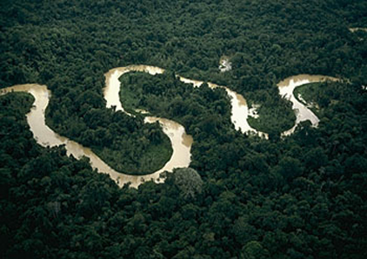
The Amazon Rainforest, roughly the size of Australia, is one of the world’s greatest natural resources and it is now being destroyed at an alarming rate. Two of the most prominent problems right now in the Amazonian region are land conflicts (over land reform and distribution) and balancing economic development with the preservation of the valuable rainforest.

Slide 3
Amazon Rainforest Facts and Intro to Amazon Rainforest Deforestation

Slide 4
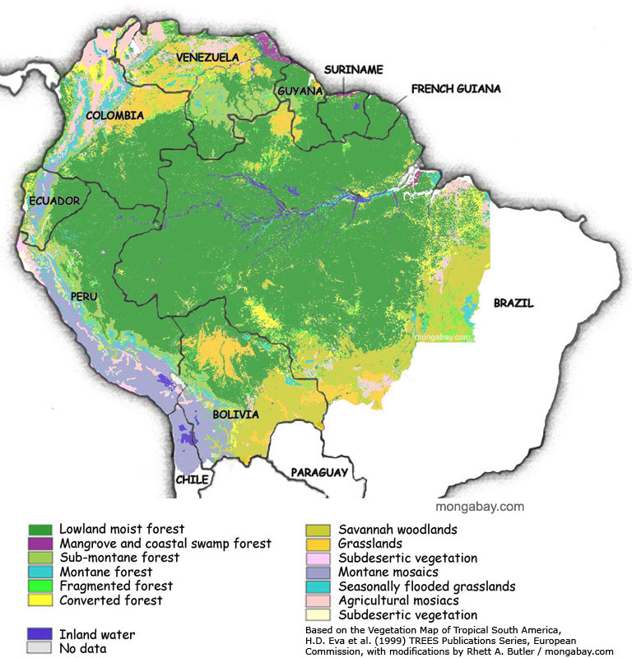
Left: map of the Amazon Rainforest, clearly showing the 9 countries it reaches into: Brazil, Bolivia, Peru, Ecuador, Colombia, Venezuela, Guyana, Suriname, and French Guiana
Right:
Human Impact 2050 Map
http://globalis.gvu.unu.edu/

Slide 5
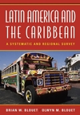
A portrait of the Amazonia Region from Latin America and the Caribbean (pp.50 and 426-444):
Demand for dietary, pharmaceutical, and material goods created from species found only in the Amazon (30% of the world’s species are here)- extract those goods- the remaining forest area is burned- grass and small shrubs grow back- the land is used as cattle ranches (soil fertility is greatly diminished)
Climate affected by the deforestation (p. 50)
“Amazonia is being destroyed while being developed.” (426)
Rondonia, a state in the western Amazon region of Brazil, has already lost 1/3 of it’s land cover to deforestation
Soybean farming has grown drastically in recent years. It contributes to the destruction of the Amazon mostly by pushing the cattle ranches further into the region.
1-2% of the remaining Amazon Rainforest lands are being destroyed each year
Politics affecting the rainforest: creation of several organizations

Slide 6
Effects of Earth Summit 1992 in Rio de Janeiro on the Amazon Rainforest
Simply, “Rio's strategic vision that free trade would stabilize global climate, protect endangered species, and slow deforestation has proven catastrophically wrong.”
The rate of devastation and deforestation in the Amazon Rainforest has increased by 1/3 since the Summit at Rio.
Thought at the Summit was that the best way to keep the forests protected was to protect the rights of the indigenous inhabitants.
President Fernando Henrique Cardoso enacted Brazil Action, a plan to build trade infrastructure in order to expedite the nation’s natural resources and with an aim to increase the global competitiveness of Brazil.
Economic development moving towards ecological sustainability was another goal of the Summit.
(Mencotti)

Slide 7
Review of the Efficiency and Effectiveness of Colombia’s Environmental Policies- RFF Report
In Colombia, industry along with farming, ranching, and logging have brought a great deal of degradation to the Amazon Rainforest areas.
In the past 50 years, 22% of all the crop fields, pastures, forest area, and woodlands have been destroyed.
Anthropogenic factors (farming, urban development, mining, and logging) are important in relation to public policy because these are generally easier to prevent through government initiatives.
Soil degradation is an extreme economic expense considering how many goods come from the resources of the soil. The cost of land degradation is larger than the cost of any other type of environmental issue in rural Colombia.
Cattle ranching in Colombia: more than twice the suitable amount to be used for ranching is being used for that purpose and this land displaces forest and agricultural lands
17% of Colombian land is being overused. 180,000 hectares of Colombian forest have been reforested between 1991 and 2002.

Slide 8
Causes of Deforestation in Colombia
73% Expansion of the agricultural area and colonization
12% Lumber production
11% Firewood consumption
2% Forest fires
2% Illegal crops
Data from Table 5.16 of RFF Report

Slide 9
Amazon Deforestation in Colombia
Rhett A. Butler, 2006

Slide 10
Environmental Law in Colombia
The Ministry of Environment is in charge of regulating all environmental matters relating to land use.
Law 388 went into effect in 1997 and is the primary land use planning law in Colombia. The objective is to rationalize the development and exploitation of the land.
Decree 2202 of 1939 establishes that any burning, destruction of the forest, or attempts to use forest resources for private gain is illegal.
Decree 2787 of 1980 asserts that any agent that exploits public forest land much restore the resources destroyed.
Decree 1135 of 1983 created economic incentives for conservation is specific areas of Colombia.
Decree 900 of 1997 created a forest conservation certificate that is given to forest land owners who leave their land undisturbed. This provides economic incentive to keep protecting the forest.
(Blackman)

Slide 11
Human Pressure on the Brazilian Amazon Forests- WRI report
Remaining tropical rainforest in the world: 40% in Brazil
Millions of people depend on the Amazon both directly and indirectly
Amazon is subject to much pressure from these millions
Approved development leads to unplanned deforestation as the settlements expand to survive
President Fernando Henrique Cardoso established Amazon Region Protected Areas
80% of deforested area is within 30 km of an official road
“arc of deforestation”
Agrarian Reform Settlements- land given to landless people to farm
Cattle ranching, urban development, farming, and burning are all seen in the region
Overlap in deforestation and use of those lands

Slide 12
Deforested Areas in Motto Grasso, Brazil

Slide 13
Amazon Rainforest Deforestation News Articles
“Brazil launches deforestation plan”
A new initiative in Brazil was established to monitor the land use of the rain forest to hopefully reduce the amount of illegal deforestation in the Amazon. A landholder registry will be created and enforcement troops will be sent out to police the region. Land owners will be required to register, and if they don’t they will no longer be able to receive government loans and other benefits from the Brazilian government. President Luiz Inacio Lula da Silva has already approved the plan. (Astor)
“Zero’ Amazon Deforestation Possible by 2015, Brazilian NGOs Say”
Brazilian non-governmental organizations have created a proposal entitled “The Agreement on Acknowledging the Value of the Forest and Ending Amazon Deforestation.” It is a plan to stop clear-cutting in the Amazon rainforest by 2015. Their aim is to unite the Brazilian government and civilians and combining public policies and market strategies. (Herro)

Slide 14
References: Books and Websites
Astor, Michael. “Brazil launches anti-deforestation plan.” Associated Press. Rainforest Portal. 21 December 2007. 18 February 2008. http://rainforestportal.org/shared/reader/welcome/aspx?linkid=90566
Barreto, Paulo, Carlos Souza Jr., Ruth Nogueron, Anthony Anderson, and Rodney Salomao. “Human Pressure on the Brazilian Amazon Forests”. World Resources Institute Report 2006. 12 April 2008. http://www.globalforestwatch.org/common/pdf/Human_Pressure_Final_English.pdf
Blackman, Allen, Richard Morgenstern, Librado Montealegre Marcia, and Juan Carlos Garcia de Brigard. Review of the Efficiency and Effectiveness of Colombia’s Environmental Policies. Resources for the Future. August 2006. 11 March 2008. http://rff.org/rff/Documents/RFF-Rpt-ColoEPEfficiency.pdf
Blouet, Brain W., and Olwyn M. Blouet. Latin America and the Caribbean: A Systematic and Regional Survey. 5th Edition. Hoboken, NJ: John Wile & Sons, Inc., 2006.

Slide 15
References: Books and Websites
Ethaslanded. “Amazon Rainforest Forever (English version)”. 11 July 2007. Online video clip. YouTube. Accessed on 8 April 2008. http://www.youtube.com/watch?v=COW943mgEMc
Herro, Alana. “Zero Amazon Deforestation Possible by 2015, Brazilian NGOs Say.” Eye on Earth. Worldwatch Institute: Vision for a Sustainable World. 10 October 2007. 28 February 2008. http://worldwatch.org/node/5392
Menotti, Victor. “Globalization and the Acceleration of Forest Destruction Since Rio.” International Forum on Globalization. 13 April 2008. http://www.ifg.org/programs/forest.htm
Wood, Charles H., and Roberto Porro. Deforestation and Land Use in the Amazon. Gainesville, FL: University Press of Florida, 2002.

Slide 16
References: Images
http://www.unique-southamerica-travel-experience.com/images/49am95-copia.jpg
http://www.galapagos-inc.com/amazon_pic/1.jpg
http://photos.mongabay.com/07/brazil/amazon_basin_map-max.jpg
http://globalis.gvu.unu.edu/
http://media.wiley.com/product_data/coverImage/50/04716309/0471630950.jpg
http://www.eoearth.org/upload/thumb/d/dd/RioEarthSummit1992.jpg/200px-RioEarthSummit1992.jpg
http://news.mongabay.com/images/2006/0322.jpg
http://www.rainforestrelief.org/documents/Causes_of_RF_Destruction.gif
http://travel.mongabay.com/colombia/150/co01-9140.jpg
http://earthobservatory.nasa.gov/Newsroom/NewImages/Images/Brazil_TMO_june2002_2006.jpg

